Slide 1







CSM3114 FRAMEWORK-BASED MOBILE APPLICATION DEVELOPMENT
PROJECT 2
Haulify
HAULIER TRACKING APPLICATION
by: Nuha Nordin

Slide 2
Executive Summary
Main goal
Solution
Improves efficienct, transparency of truck movements
Combination of user interface and backend features
Difficulties due to manual and inefficient tracking
Better manage trucks, effectively plan routes
Problem

Slide 3
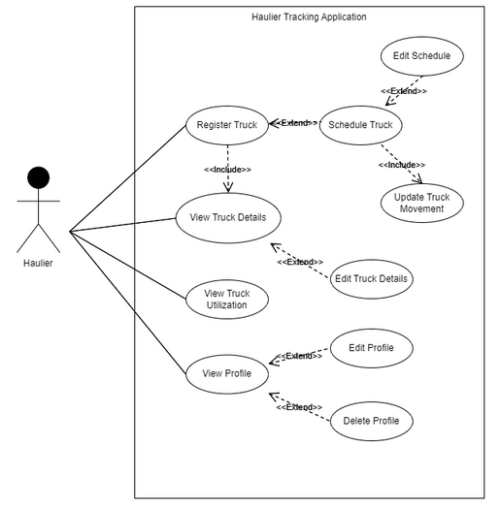
Use Case
User
Use Cases
Haulier
Register Truck
(optional) Schedule Truck
(optional) Edit Schedule
(mandatory) Update Truck Movement
View Truck Details
(optional) Edit Truck Details
View Truck Utilization
View Profile
(optional) Edit Profile
(optional) Delete Profile
Use Case Diagram

Slide 4
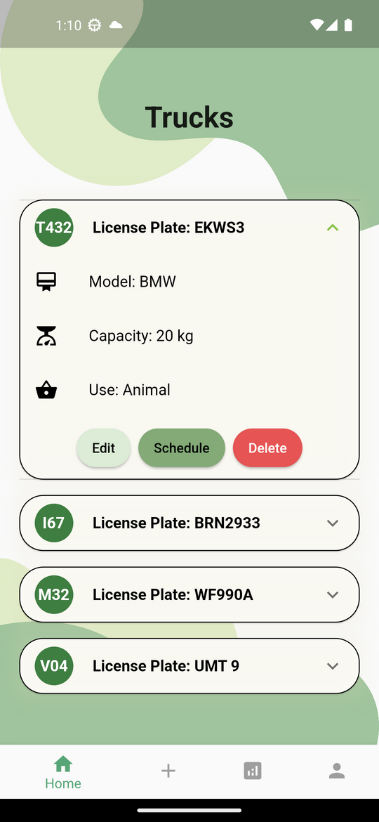
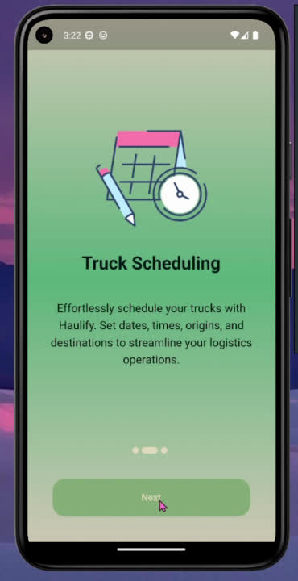
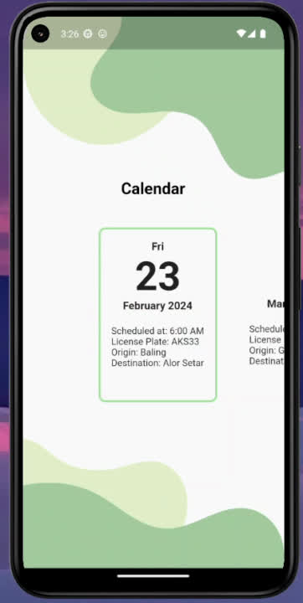
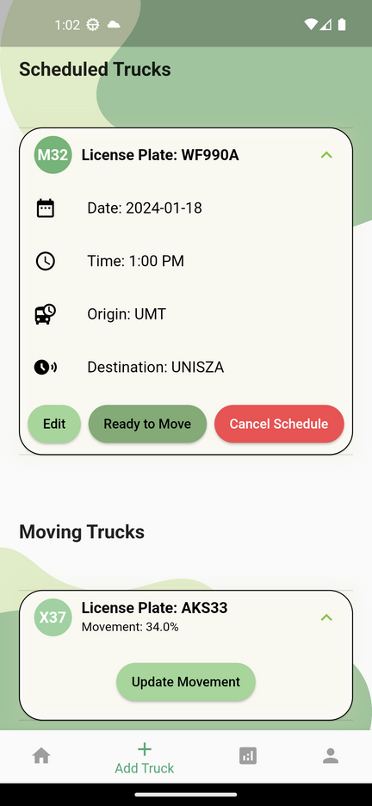
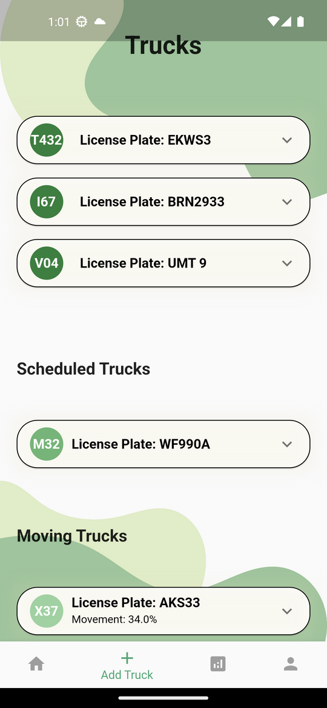
Flutter Widgets and Features Adopted
BottomNavigationBar
PageView
ScrollSnapList
ExpansionTile
ListView

Slide 5
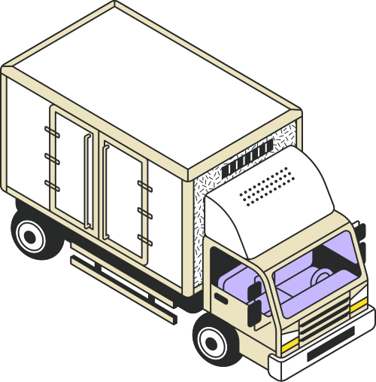
Conclusion
1
Flutter Utilization
Helped to create helps that user-friendly and effective while streamlining the development process.
2
Lesson Learned
Additional innovation and improvement in tracking solutions

Slide 6

Thank you

